Slide 1
Chapter 3: Functional Programming
Harikala Kandel
CSP101 – Programming Paradigm

Slide 2
Functional Programming Paradigm
We now study a programming paradigm which gives full respect to these two concepts:
Computation is about values
Functions can be defined and used as values
Why is this useful to learn?
Functional programs can be argued to be correct

Slide 3
concurrent programs are naturally written using functional concepts (will see later lecture)
Functional concepts are increasingly being included and used in mainstream programming languages

Slide 4
Overview
Von Neumann architecture and ‘state’
Problems with ‘state’ and side-effects
Functions for programming
No side effects
Referential transparency
High-order programming

Slide 5
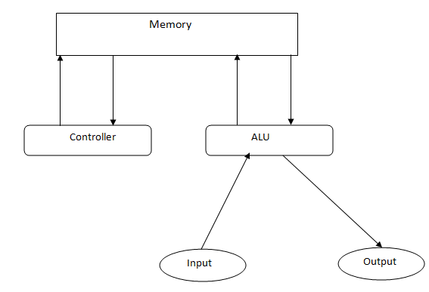
Concept of Von Neumann Architecture

Slide 6
Von Neumann bottleneck
All information between CPU and memory must pass along a single connection
The bottleneck is about the flow of information between the memory and the CPU
Imperative languages like Fortran and C manage that flow explicitly

Slide 7
Von Neumann bottleneck…
Object-oriented languages like Java remove a good deal of this implemental burden, but there remains a conceptual burden: objects have ‘state’
When the results of methods depend on a stored state you have to care about that state

Slide 8
Key Elements:
Some key elements of functional Programming are:
No mutable state
No side effects
Functions are first order values and maps input and output
Referential transparency: elements in a program can be replaced by their values
Garbage collection
Polymorphism
Evaluation can be ‘lazy’ or ‘eager’.

Slide 9
Claims for Functional Programming
Claims made for FP:
Shorter programs (up to 25 % of size)
Easier to understand
Shorter, and
No content to confuse the meaning
Better reliability, as properties of programs may be proved mathematically
Ideal for parallel computing
For example, Google’s map/reduce framework

Slide 10
Other examples:
XSLT:
style sheet transformations are functional in form,
having no state,
no variables
each transform is defined purely by its input.
SQL:
Database queries do not provide mutable variables
F#:
Functional Programming on .net framework.

Slide 11
Functional Programming Paradigm
Functional Programming become popular because-
it removes the complexity of one dimension
Function just take parameter and give you a result without any side effect
Function don’t depend the history what happen before and
they don’t influence the history what happens after

Slide 12
Functional Programming Paradigm
We now study a programming paradigm which gives full respect to these two concepts:
computation is about value
functions can be defined and used as values

Slide 13
Functional Programming:
Aim:
The aim of functional language is to avoid the von Neumann bottleneck.
Facilitates
An imperative way of thinking:
How things are stored in memory
Which operation can affect that memory
Treat values and process as their own, not their representation by a computer.

Slide 14
Features of FP
Immutability
Once we define a variable, it must not be changed during the run-time.
Referential Transparency
A pure function always returns the same results for the given set of parameters
Eg, Π =3.14 , sin(0) = 0
Eliminate side effects
A pure function never changes a state outside of its scope.

Slide 15
Features of FP…
No external dependencies
A pure function doesn’t depend on external state and relies only on the parameters.
Higher-Order functions
A higher-order function can accept another functions as arguments and returns a function or a value.

Slide 16
Feature of FP
First-class Functions: A function can be passed as argument to other functions, returned as value from other functions and assigned to variables

Slide 17
Simple Example
Imperative
int [] a={1,2,3}
for(int i=0;i<a.length;i++){
a[i]=a[i]*2;
}
Functional
int [] a={1,2,3}
for(int i=0;i<a.length;i++){
a[i]=Math.pow(a[i]),2);
}

Slide 18
Key Difference:
Unlike imperative programming, there is no notion of state and therefore:
No need for an assignment statement
The effect of a loop is achieved via recursion
There is no way to increase or decrease the value of variable in the state
There are no variables
However, must functional languages support the notions of variable, assignment and looping (not part of pure functional program).

Slide 19
Scala: Defining a Function
A simple version (for one-liners):
def double (x:Int):Int= x*2
Multi-line version:
def double (x:Int): Int= {
Var res: Int=x*2
Return res
}
Anonymous version:
(x:Int)=>x*2

Slide 20
Scala: Typical values
Numbers, string, booleans all as you would expect
1, 2, 3.14
“abc”, “Programming Paradigms”
true, false
Variables must be identified as such:
var x= 3
var creates variables whose value can not be changed

Slide 21
val creates variables whose value can not be changed
types optional but sometimes needed to avoid confusion (in the compiler)

Slide 22
Scala: Lists
In place of arrays we use Lists. To create a list:
List(1,2,3,4)
Notice, no types…Scala infers the type but sometimes we need to help it (see keepEvens):
Do something to every item in a list using foreach
Do something to every item in a list and keep the results using map

Slide 23
Scala: Lists…
We can join two lists together using List.concat
Add an item to the front of a list using ::
The empty list is called Nil

Slide 24
Review: Thinking about Functions
int c=0 ;
int f(){ int g(){
c=c+2; c= c*2;
return c; return c;
} }
void main(){
printf(“%d\n”, f()+g());

Slide 25
If you calculate f() first and then g(), what is printed?
If you calculate g() first and then f(), what is printed?
How does this compare with how we usually think of arithmetic?

Slide 26
Referring to Processes
Consider the following two programs
What is different?
What is same?

Slide 27
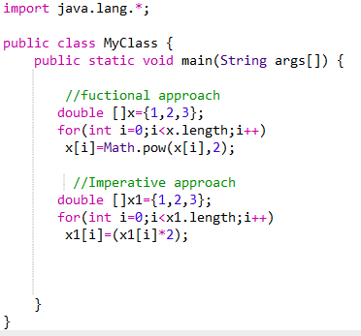

Slide 28
Functions:
Functions are very important in functional programming
A function takes one or more input values and (usually) return a value.
A function has a name

Slide 29
Functions as First-class values
To become “first-class”, functions :
Function can be assigned to variables
Passed to other functions as parameters and
Returned as values (results) from other functions
A higher-order function does one or both of:
Returns a function as a result
Accepts functions as arguments

Slide 30
Functions: store values in variables
Simplest case: create an anonymous function and give it a (variable) name
var fn= (x:Int)=>x*2
Note, how similar is this to create a string and giving it a (variable) name
var str= “abc”
In both cases, we name the value in order to use it later:
fn(2) //call the stored function on value 2

Slide 31
Function: passed a arguments
We already met this with ‘foreach’ and ‘map’ on lists:
var fn= (x:Int)=>x*2
var a = List(1, 2, 3, 4)
println(a.map(fn))

Slide 32
Functions: Returned as Results
We know how to make an anonymous function and how to store an anonymous function
How can we make function?
def makeAdderrFunction (x:Int)= (y:Int)=> x+y
var add1= makeAdderFunction(1)
var add2= makeAdderFunction(2)

Slide 33
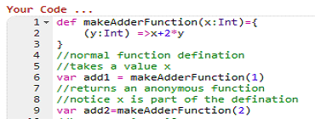
Functions: Return as results
In scala,

Slide 34
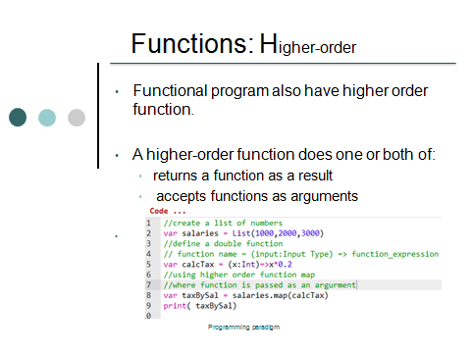

Slide 35
Function definition
Previously, we defined a function as:
def double (x:Int):Int= x*2
Now we have:
var fn= (x:Int)=>x*2

Slide 36
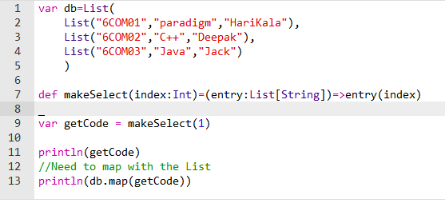
Example: Selecting list items
Consider a database stored as a list of lists:

Slide 37
Scala Types
Simple types
Int String
var x:Int=3
var y:String=“abc”
Collection types
List[Int] List[String]
Def fn(x:List[Int])
Function types
(Int)=>Int
(List(String)=>Int

Slide 38
Accumulator Functions
A typical “pattern” in functional programming is to accumulate a value across a list.
This is often known as “fold”, “reduce” or sometimes “scan”

Slide 39
Consider adding up a list of numbers:
def addUp(lst:List[Int]:Innt={
var res:Int =0
lst.foreach((x:Int)=>res= res+x)
return res
}
Task: Change this to multiply a list of numbers

Slide 40
Accumulator Function Pattern
General pattern: note the initial value and operator
def accumulate(lst:List[Int],
initial:Int
fn: (Int, Int)=>Int): Int={
var res: Int= initial
lst.foreach ((x:Int)=>res= fn(x, res)
Return res
}
This pattern is called “fold” (left)

Slide 41
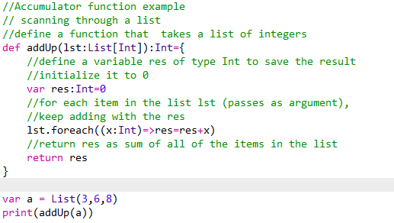
Accumulator Example:

Slide 42
Functions:
Here,
The double function is passes as an argument to the list’s map function
This is a key trait of functional programming.
Task1
Run above code
Task 2
Define a function to treble a number
Now treble every number in the list and print the result.

Slide 43
Example1: sum to N
Remember the problem “Given N, returns the sum of all numbers from 1 to N” (assume N>=0)
def sumN(n:Int):Int={
if(n==0){
return 0
}
else{
n+sumN(n-1) //do the simple problem
}
}

Slide 44
Example2: sum numbers in List
Similar problem, but we want to just add the numbers in a list
def sumList(lst:List[Int]):Int={
if(lst.isEmpty){
return 0
}
else{
lst.head+sumList(lst.tail)
}
}

Slide 45
Example: Pattern Matching
def sumN(n:Int):Int={
n match{
case 0=>0
case_ => n+sumN(n-1)
}
}
It means match anything the function is still recursive

Slide 46
Functions:
In Ruby
def double(x)
x*2
end
In Java
int double (int x){
return x*2
}
In Scala
def double(x:Int): Int = x*2

Slide 47
Functions:
In functional programming, functions are first-class values.
To be “first-class”, functions must support being:
stored in variables as values
passed as arguments to functions
returned as results from functions
i.e. just like variables, we can create, store or pass them around

Slide 48
Functions: Passing as arguments
In scala,
//create a list of number
var l=List(1,2,3)
//define a double function
def double(x:Int):Int=x*2
//call map on list, passing the double function as an argument
println(“Double: ”+l.map(double))

Slide 49
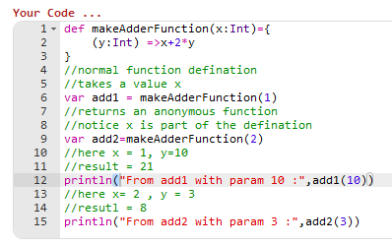
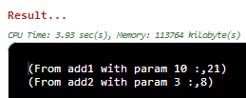
Scala example

Slide 50
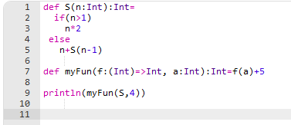
Find the output…..
Notes:
In line number 9 the function ‘S’ and the number 4 are passed as arguments to the function myFun
How it works:
MyFun calls the function S with the value 4 as its argument and the function S returns the value 8 to myFun.
myFun add 5 to the value returned by S, giving 13, which is returned by myFun.
The value 13 is passed to println, which output 13 to the screen.

Slide 51
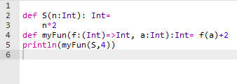
Find the Output…
Notes:
In line number 5 the function ‘S’ and the number 4 are passed as arguments to the function myFun.
How it works:
MyFun calls the function S with the value 4 as its argument and the function S returns the value 8 to myFun.
myFun add 2 to the value returned by S, giving 10, which is returned by myFun.
The value 10 is passed to println, which output 10 to the screen.

Slide 52
Functions:
Task3
let ‘s do string.
a.length() will returns the length of the string
Write a scale its length. function which takes a string as its argument and returns.
Task4
Now, create a list of 3 or 4 strings of different size
Compute the lengths of the strings and display them.

Slide 53
Recap: Functional Programming
Functional programming concept was created for AI and PhD research purpose but it is widely used in industrial contexts
Function just take parameter to give you result without any side-effect
It solves Von Neumann architecture’s bottleneck problem
immutability
No external dependencies
High- order functions etc. are key features

Slide 54
Class work
Write a program in Java or C to find the nth term in the Fibonacci sequence.
Write a same program in scala using a feature “function can be used as a value”,

Slide 55
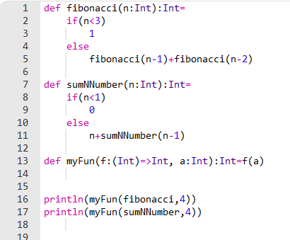
In Scala: Function is passed as an Argument

